Slide 1
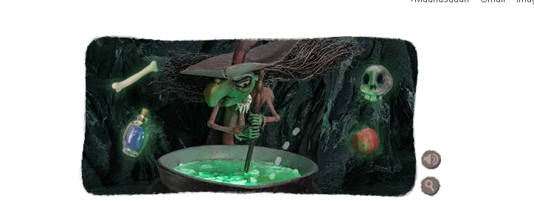
Big O and Algorithms (Part 1)
by Google today
Discrete Structures (CS 173)
Madhusudan Parthasarathy, University of Illinois

Slide 2
Announcements
Midterm 2: how did it go?
All the usual homeworks due this week

Slide 3
This week
How do we characterize the computational cost of an algorithm?
How do we compare the speed of two algorithms?
How do we compute cost based on code or pseudocode?

Slide 4
Today
How do we characterize the computational cost of an algorithm?
How do we compare the speed of two algorithms?
How do we compute cost based on code or pseudocode?

Slide 5
How should we think about an algorithm’s computational cost?
Time taken?
Number of instructions called?
Expected time as a function of the inputs?
How quickly the cost grows as a function of the inputs

Slide 6
Example: Finding smallest m values
output = findmin(input, m) % returns m smallest inputs
for each ith output (there are m of these)
for each jth input (there are n of these)
if j is not used and input(j) < output(i)
output(i) = input(j);
j_out = j;
end
end
mark that j_out has been used as an output
end
return output
See findmin.m

Slide 7
Example: Finding smallest m values
minvals = findmin(vals, m)
$$Cost=k1+k2n+k3m+k4mn$$
$$Cost is O(mn)$$
Constants that depend on implementation details, architecture, etc.
Dominant factor

Slide 8
Key ideas in runtime analysis
Model how algorithm speed depends on the size of the input/parameters
Ignore factors that depend on architecture or details of compiled code
We care mainly about asymptotic performance
If the input size is small, we’re not usually worried about speed anyway
We care mainly about dominant terms
An algorithm that takes $n^{2}$ time takes almost as long (as a ratio) as one that takes $30+4n+n^{2}$ time if $n$is large

Slide 9
Asymptotic relationships
$f(n)$ $g(n)$
$3+n^{2}+sqrt\left(n\right)$ $n^{2}$
$2+{2n}^{2}+n$ $n^{2}$
$1000+100n$ $n^{2}$
$2^{n}+n$ $n!$
$n^{5}$ $2^{n}$
$nm$ $n\log{n}$
If $f\left(n\right)≪g(n)$, then $f\left(n\right)h\left(n\right)≪g\left(n\right)h(n)$ for non-zero $h(n)$

Slide 10
Ordering of functions
$$1≪\log{n≪\sqrt{n}≪n≪n\log{n}≪n^{2}}$$
$$n^{2}≪n^{3}≪2^{n}≪3^{n}≪n!$$

Slide 11
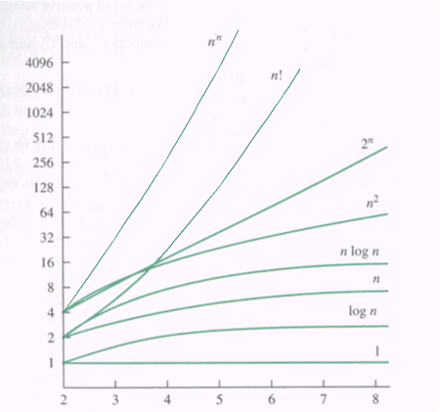

Slide 12
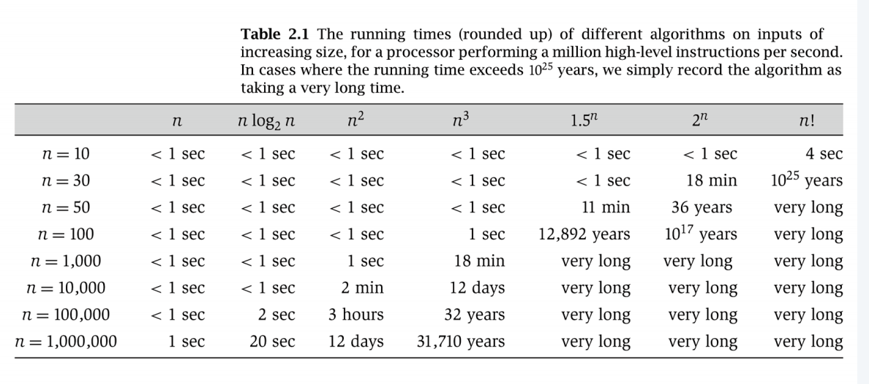

Slide 13
Example: comparing findmin algorithms
output = findmin(input, m) % can be implemented different ways
for each ith output (there are m of these)
for each jth input (there are n of these)
if j is not used and input(j) < output(i)
output(i) = input(j);
j_out = j;
end
end
mark that j_out has been used as an output
end
return output
output = findmin_sort(input, m)
sorted_input = sort(input, ascending);
output = sorted_input(1…m);

Slide 14
Big-O: motivation

Slide 15
Big-O
$f\left(n\right)$ is $O(g\left(n\right))$ iff there are $c>0, k>0$ such that $0≤f\left(n\right)≤cg(n)$ for every $n≥k$
$f(n)$ O($g(n))?$
$3+n^{2}+sqrt\left(n\right)$ $n^{2}$
$2+{2n}^{2}+n$ $n^{2}$
$n^{3}$ ${n+n}^{2}$
$1000+100n$ $n^{2}$
$n^{5}$ $2^{n}$

Slide 17
$Θ\left(g(n)\right)$
$f\left(n\right)$ is $Θ(g\left(n\right))$ if $f\left(n\right)$ is $O(g\left(n\right))$ and $g(n)$ is $O(f\left(n\right))$
$f(n)$ $Θ\left(g\left(n\right)\right)?$
$3+n^{2}+sqrt\left(n\right)$ $n^{2}$
$2+{2n}^{2}+n$ $n^{2}$
$1000+100n$ $n^{2}$
$2^{n}+n$ $n!$
$n^{5}$ $2^{n}$
$nm$ $n\log{n}$

Slide 18
Proving Big-O with induction
Claim: ${10n}^{2}$ is $O(2^{n})$
Definition: $f\left(n\right)$ is $O(g\left(n\right))$ iff there are $c>0, k>0$ such that
$0≤f\left(n\right)≤cg(n)$ for every $n≥k$.
Choose $c$ and $k$: $c=10$, $k=4$
Proof: Suppose is an integer. I need to show $10n^{2}≤{10⋅2}^{n}$ for $n≥4$. I will use induction on $n$.
Base case:
Induction: Suppose $10n^{2}≤10⋅2^{n}$ for $n=4, 5, …, k$. We need to show $10{\left(k+1\right)}^{2}≤10⋅2^{k+1}$.
Notes:
10k^2 + 20k+10 <= 10.2^k + 10.2^k
10k^2+20k+10 <= 10.2^k + 10(2k+1) <= 10.2^k+10.2^k
As 2k+1 <10.2^k, for k>3.

Slide 19
Things to remember
Model algorithm complexity in terms of how much the cost increases as the input/parameter size increases
In characterizing algorithm computational complexity, we care about
Large inputs
Dominant terms
$1≪\log{n≪\sqrt{n}≪n≪n\log{n}≪}n^{2}≪n^{3}≪2^{n}≪3^{n}≪n!$
$f\left(n\right) is O(g\left(n\right))$ if the dominant terms in $f(n)$ are equivalent or dominated by the dominant terms in $g(n)$
$f\left(n\right) is Θ(g\left(n\right))$ if the dominant terms in $f\left(n\right)$ are equivalent to those in $g(n)$

Slide 20
Next class
Analyzing pseudocode

